Slide 1

Kinetic Characterization of the enzyme and study of substrate inhibition
Laxman Manjhi 2019BB10034
Ratnesh Kumar Sharma 2019BB10047

Slide 2

Background
The experiment involves the kinetic characterization of an enzyme, which can be determined by calculating the values of Km and Vmax.
The Lineweaver-Burk plot is a graph of 1/V vs 1/[S], which can be used to determine the values of Km and Vmax.
Eisenthal and Cornish-Bowden suggested a new approach to determine Km and Vmax, which involves plotting a hypothetical graph of Vmax vs Km at a constant [S] and V.
Inhibition of enzyme-catalyzed reactions can occur through three main mechanisms: competitive, non-competitive, and mixed inhibition.
The effect of inhibitors on the kinetic parameters of the enzyme can be expressed mathematically using the equations for competitive, non-competitive, and mixed inhibition.

Slide 3
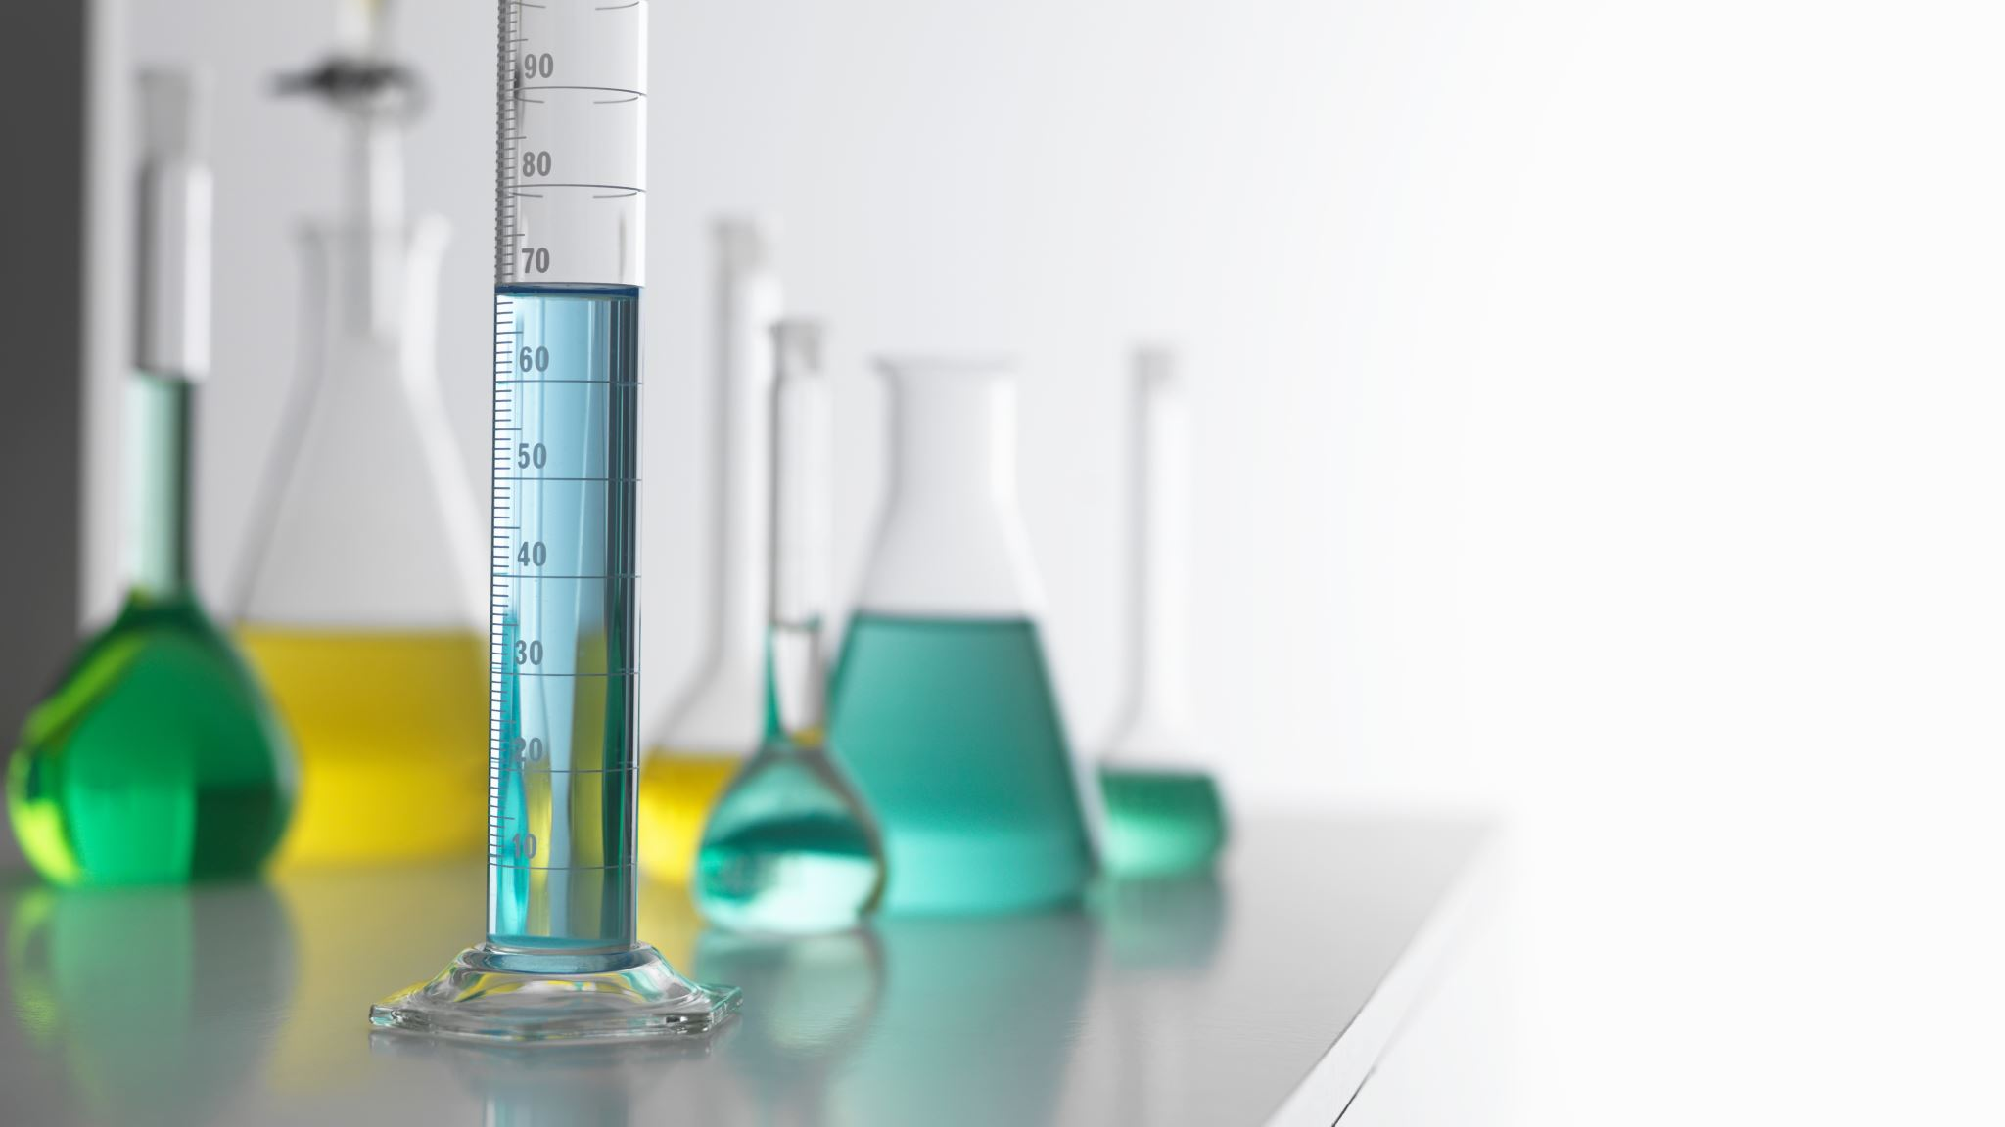
Procedure
A total of 5µL of the sample was taken and added to 50µL of freshly prepared and diluted sucrose solution and 545µL of distilled water/CuSO4 concentration 1/CuSO4 concentration 2.
The mixture was incubated at 30°C for 5 minutes.
After the incubation, 200µL of alkaline DNS was added to the mixture.
The mixture was further incubated at 90°C for 5 minutes.
Next, 200µL of 50mM sodium acetate buffer with pH 4.8 was added to the mixture.
A blank was prepared with 50µL of distilled water in place of sucrose.
The absorbance readings of all the samples were taken at 540nm using a spectrophotometer.
The Lineweaver-Burk plot was plotted for all three cases.
The equipment used, such as the spectrophotometer, water bath, cuvettes, pipettes and tips, and Eppendorfs, were properly cleaned and maintained before and after use.
The reagents used, including 1M sucrose solution, alkaline DNS, 50mM sodium acetate buffer with pH 4.8, 100IU/ml invertase enzyme, CuSO4 (two concentrations), and distilled water, were of high quality and freshly prepared.

Slide 4
Observation
Sucrose conc. | Set 1 (water) | Set 2 (Inh 1) | Set 3 (Inh 2)
0 | 0 | 0 | 0
50 | 0.03 | 0.008 | 0.015
100 | 0.033 | 0.011 | 0.058
150 | 0.018 | 0.034 | 0.023
200 | 0.035 | 0.065 | 0.006
250 | 0.043 | 0.069 | -0.003

Slide 5
Reaction rate calculation
Set 1 (water)
C1 (mM) | Abs. for C2 | ε (mM^-1 cm^-1 | l (cm) | Df | C2 (mM) | C1-C1 (mM) | t (min) | v = ΔC/t
0 | 0 | 14.2 | 1 | 1000 | 0.000 | 0 | 5 | 0.00
50 | 0.03 | 14.2 | 1 | 1000 | 2.113 | 48 | 5 | 9.58
100 | 0.033 | 14.2 | 1 | 1000 | 2.324 | 98 | 5 | 19.54
150 | 0.018 | 14.2 | 1 | 1000 | 1.268 | 149 | 5 | 29.75
200 | 0.035 | 14.2 | 1 | 1000 | 2.465 | 198 | 5 | 39.51
250 | 0.043 | 14.2 | 1 | 1000 | 3.028 | 247 | 5 | 49.39
Set 2 (Inh 1)
C1 (mM) | Abs. for C2 | ε (mM^-1 cm^-1 | l (cm) | Df | C2 (mM) | C1-C1 (mM) | t (min) | v = ΔC/t
0 | 0 | 14.2 | 1 | 1000 | 0.000 | 0 | 5 | 0.00
50 | 0.008 | 14.2 | 1 | 1000 | 0.563 | 49 | 5 | 9.89
100 | 0.011 | 14.2 | 1 | 1000 | 0.775 | 99 | 5 | 19.85
150 | 0.034 | 14.2 | 1 | 1000 | 2.394 | 148 | 5 | 29.52
200 | 0.065 | 14.2 | 1 | 1000 | 4.577 | 195 | 5 | 39.08
250 | 0.069 | 14.2 | 1 | 1000 | 4.859 | 245 | 5 | 49.03
Set 3 (Inh 2)
C1 (mM) | Abs. for C2 | ε (mM^-1 cm^-1 | l (cm) | Df | C2 (mM) | C1-C1 (mM) | t (min) | v = ΔC/t
0 | 0 | 14.2 | 1 | 1000 | 0.000 | 0 | 5 | 0.00
50 | 0.015 | 14.2 | 1 | 1000 | 1.056 | 49 | 5 | 9.79
100 | 0.058 | 14.2 | 1 | 1000 | 4.085 | 96 | 5 | 19.18
150 | 0.023 | 14.2 | 1 | 1000 | 1.620 | 148 | 5 | 29.68
200 | 0.006 | 14.2 | 1 | 1000 | 0.423 | 200 | 5 | 39.92
250 | -0.003 | 14.2 | 1 | 1000 | -0.211 | 250 | 5 | 50.04

Slide 6
Without Inhibitor
Set 1 (water) | Without Inhibitor
C1 (mM) | Abs. for C2 | ε (mM^-1 cm^-1 | l (cm) | Df | C2 (mM) | C1-C1 (mM) | t (min) | v = ΔC/t | 1/[S] | 1/V
0 | 0 | 14.2 | 1 | 1000 | 0.000 | 0 | 5 | 0.00
50 | 0.03 | 14.2 | 1 | 1000 | 2.113 | 48 | 5 | 9.58 | 0.020 | 0.104
100 | 0.033 | 14.2 | 1 | 1000 | 2.324 | 98 | 5 | 19.54 | 0.010 | 0.051
150 | 0.018 | 14.2 | 1 | 1000 | 1.268 | 149 | 5 | 29.75 | 0.007 | 0.034
200 | 0.035 | 14.2 | 1 | 1000 | 2.465 | 198 | 5 | 39.51 | 0.005 | 0.025
250 | 0.043 | 14.2 | 1 | 1000 | 3.028 | 247 | 5 | 49.39 | 0.004 | 0.020

Slide 8
With Inhibitor (1mM)
Set 2 (Inh 1) | With Inhibitor (1mM)
C1 (mM) | Abs. for C2 | ε (mM^-1 cm^-1 | l (cm) | Df | C2 (mM) | C1-C1 (mM) | t (min) | v = ΔC/t | 1/[S] | 1/V
0 | 0 | 14.2 | 1 | 1000 | 0.000 | 0 | 5 | 0.00
50 | 0.008 | 14.2 | 1 | 1000 | 0.563 | 49 | 5 | 9.89 | 0.020 | 0.101
100 | 0.011 | 14.2 | 1 | 1000 | 0.775 | 99 | 5 | 19.85 | 0.010 | 0.050
150 | 0.034 | 14.2 | 1 | 1000 | 2.394 | 148 | 5 | 29.52 | 0.007 | 0.034
200 | 0.065 | 14.2 | 1 | 1000 | 4.577 | 195 | 5 | 39.08 | 0.005 | 0.026
250 | 0.069 | 14.2 | 1 | 1000 | 4.859 | 245 | 5 | 49.03 | 0.004 | 0.020

Slide 10
With Inhibitor (10mM)
Set 3 (Inh 2) | With Inhibitor (10mM)
C1 (mM) | Abs. for C2 | ε (mM^-1 cm^-1 | l (cm) | Df | C2 (mM) | C1-C1 (mM) | t (min) | v = ΔC/t | 1/[S] | 1/V
0 | 0 | 14.2 | 1 | 1000 | 0.000 | 0 | 5 | 0.00
50 | 0.015 | 14.2 | 1 | 1000 | 1.056 | 49 | 5 | 9.79 | 0.020 | 0.102
100 | 0.058 | 14.2 | 1 | 1000 | 4.085 | 96 | 5 | 19.18 | 0.010 | 0.052
150 | 0.023 | 14.2 | 1 | 1000 | 1.620 | 148 | 5 | 29.68 | 0.007 | 0.034
200 | 0.006 | 14.2 | 1 | 1000 | 0.423 | 200 | 5 | 39.92 | 0.005 | 0.025
250 | -0.003 | 14.2 | 1 | 1000 | -0.211 | 250 | 5 | 50.04 | 0.004 | 0.020

Slide 12
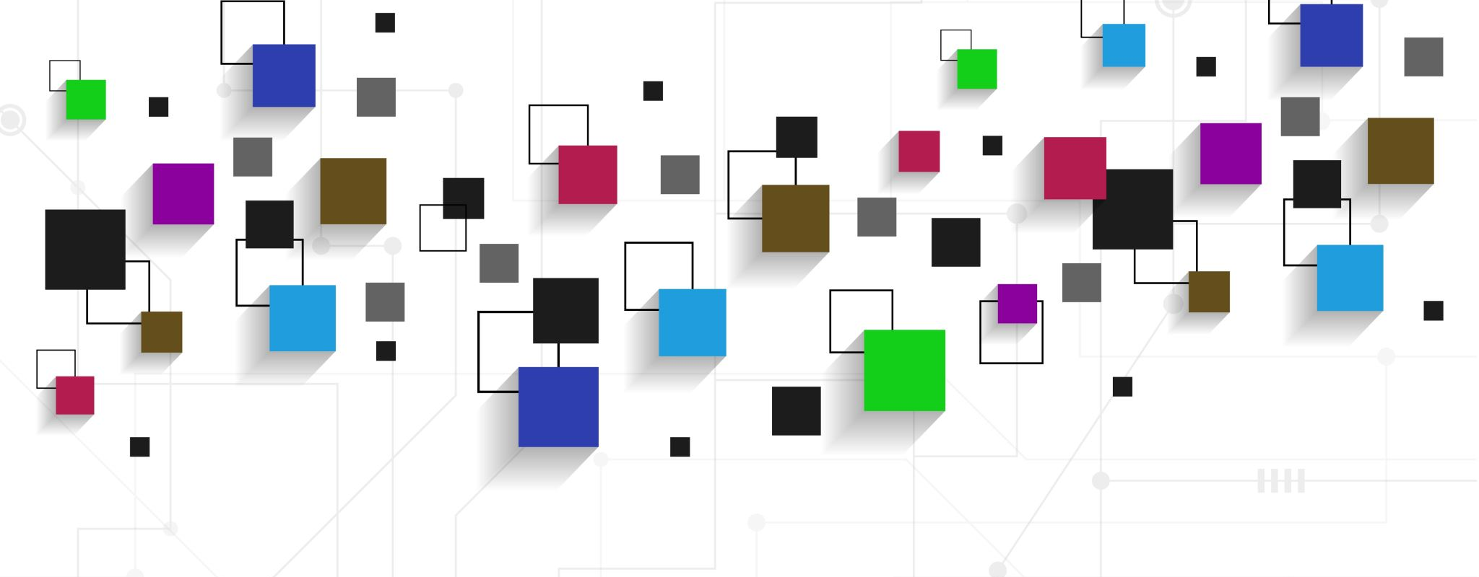
Thank you

